Slide 1
Common Ethical Missteps That Can Trip Up Lawyers
Presented by:
Heather L. Rosing
David M. Majchrzak
July 11, 2019

Slide 2
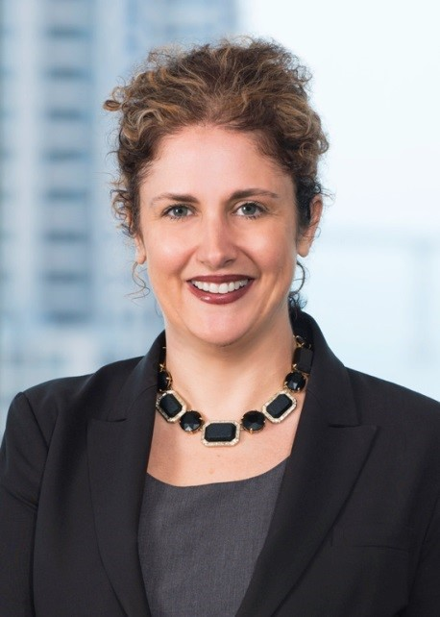
Heather L. Rosing is a shareholder and CFO for Klinedinst PC in San Diego. A graduate of the University of Illinois and Northwestern University School of Law, she is Chairperson of the firm’s Professional Liability Team, which litigates complex malpractice and fraud cases and advises in the areas of ethics and risk management.
During her four year tenure on the State Bar of California’s Board of Trustees (2011-2015), Ms. Rosing served as Vice-President, Treasurer, and Chairperson of the Regulations, Admissions, and Discipline Oversight Committee. In 2008, she was President of the San Diego County Bar Association, where she established a nationally recognized pro bono program to assist active duty military personnel under the Servicemembers Civil Relief Act, and spearheaded a Civility, Integrity, and Professionalism campaign. A certified specialist in legal malpractice and a former member of the ABA Standing Committee on Lawyers’ Professional Liability, Ms. Rosing donates much of her time to speaking and teaching free of charge on ethics and professionalism across the state and country. Also the recipient of numerous accolades, Ms. Rosing was most recently awarded Lawyer of the Year by the San Diego Defense Lawyers (2015), the Exemplary Service Award by the San Diego Volunteer Lawyer Program (2014), and # 1 Attorney in San Diego County by Southern California Super Lawyers® (2014).
2

Slide 3
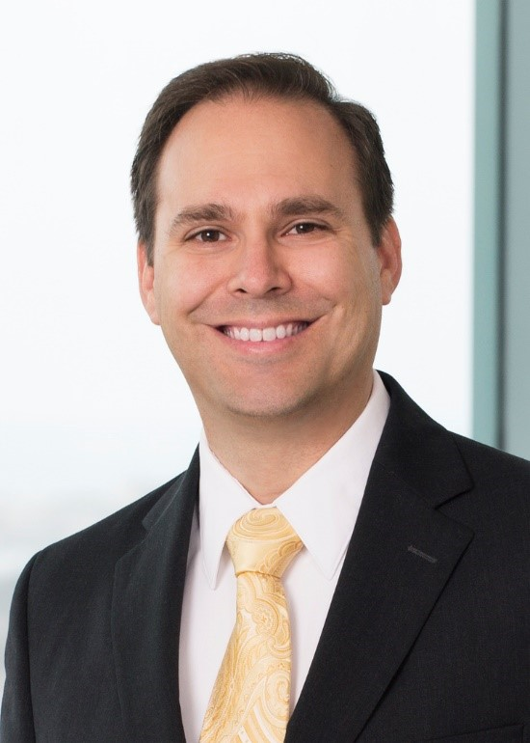
David M. Majchrzak is a shareholder with Klinedinst PC. He is certified by the State Bar of California as a specialist in legal malpractice law, and has been rate AV-Preeminent by Martindale-Hubbell. He is active within the legal community, serving as co-chair of California Lawyers Association’s Ethics Steering Committee, the immediate past chair of the San Diego County Bar Association’s Legal Ethics Committee, Secretary for both the Association of Discipline Defense Counsel and the San Diego County Bar Association. He recently completed service as a three-year member of the State Bar’s Committee on Professional Responsibility and Conduct, and chair of its outreach committee. In 2015, Dave revived the then-abandoned Ethics Quarterly, and has continued as one of its two editors. Dave has also been active within the American Inns of Court, having served for four years as president of the William L. Todd, Jr. chapter and two years on the national program awards committee. Likewise, he is active within the Association of Professional Responsibility Lawyers, having chaired and served on multiple committees.
2

Slide 4
California Lawyers Association Update
4

Slide 5
Failure to Keep Accurate Accounting
Mandated by Rule 1.15
Specific document requirements set forth in standard
Exemplars included in State Bar handbook
5

Slide 6
Engaging in Business Transactions with Clients
Governed by Rule 1.8.1
Understand when the rule is implicated
Make sure the deal is fair and reasonable to the client
Make sure the client has access to independent advice and provides informed written consent
6

Slide 7
Failure to Communicate
Mandated by Rule 1.4
Must discuss means to be employed
Must communicate significant developments
7

Slide 8
Failure to Produce File in the Correct Format or Prompt Manner
Governed by Rule 1.16(d)
Understand what constitutes “client materials and property”
8

Slide 9
Failure to Keep Confidences
Mandated by Rule 1.6 and Business and Professions Code section 6068, subdivision (e)
Often arises in situations of provocation
9

Slide 10
Mismanagement of Potential Client Relationships
Duties to prospective clients governed by Rule 1.18
Understand duties and when screening may be effective
10

Slide 11
Fee-Sharing with Non-Lawyers
Prohibited by Rule 7.2(b)
May pay reasonable costs of advertising
May pay for services of a qualified lawyer referral service
11

Slide 12
Supervision of Subordinate Lawyers and Non-Lawyer Assistants
Responsibilities addressed in new Rules 5.1 and 5.3
Reasonable steps for reasonable assurance that others comply with rules
12

Slide 13
Poor Conflict Assessment
Generally governed by Rules 1.7, 1.9, 1.10
Adversity goes beyond just being an adverse party
Screens may not be enough
13

Slide 14
Prohibited Discrimination, Harassment, and Retaliation
Governed by Rule 8.4.1
Can manifest itself in many ways
14

Slide 15
Questions?
Please contact Heather L. Rosing or David M. Majchrzak:
* hrosing@klinedinstlaw.com
* dmajchrzak@klinedinstlaw.com
( (619) 239-8131
: www.klinedinstlaw.com
Thank you for your time!
15

